Slide 1

SEMINAR PPT ON “Face Mask Detection Using CNN Algorithm for COVID-19 Prevention” COMPUTER SCIENCE & ENGINEERING During the Academic year 2020-2021 Submitted By SWATHI V 1DB17CS152 Dept. of CSE DBIT Bangalore
UNDER THE GUIDANCE:
Mrs. Vinaka Patil
Associate Prof
Dept of CSE,DBIT

Slide 2
INTRODUCTION
PROBLEM DEFINITION
LITERATURE SURVEY
OBJECTIVE
IMPLEMENTATION
RESULT
CONCLUSION
REFERENCES

Slide 3
INTRODUCTIONGENDA
The spread of COVID-19 virus and the ensuing large-scale lockdowns across the globe has given rise to an alarming situation. The resumption sectors is a key pre-requisite for kick starting economic activity of a nation.
Accordingly, processes are being put in place to educate the workforce/College regarding new safety regulations at the workplace/college which helps reduce the risk of virus transmission.
However, to help the workforce transition into a post COVID world, there was a need for us to build solutions that help monitor and alert individuals once a safety violation occurs.
We decided to built a system that takes in these feeds and analyzes frames using deep learning models to detect whether violations have occurred or not. Once detected, a real time alert is triggered in the area of the violation.
In addition, along with this alert captured violated image along with date and time is mailed that helps the authority analyze the trends and take suitable actions to curb the violations.

Slide 4
CONTD..
1)Recent work in computer vision shows face mask detection tools based on Convolutional Neural Networks(CNN) can achieve state-of-art results when trained and tested on popular public face mask datasets. 2) However, the application space of these tools are currently limited. Public face mask dataset are primarily composed of high-resolution close-up images of faces, with a large number of pixels detailing the face and mask 3) A Convolutional Neural Network (CNN) is a multi-layered neural network with a special architecture to detect complex features in data. CNNs have been used in image recognition, powering vision in robots, and for self-driving vehicles. We’re going to build a CNN capable of classifying images. 4) Once a CNN is built, it can be used to classify the contents of different images. CNNs can classify images by detecting features, like how the human brain detects features to identify objects. Images are made up of pixels. Each pixel is represented by a number between 0 and 255. Therefore, each image has a digital representation which is how computers are able to work with images.

Slide 5
PROBLEM DEFINITION
1)Due to Covid-19 pandemic situation we can’t even come in close contact with each other or can’t even touch each other.
2)Due to this situation school and colleges have been closed in order to avoid spread of covid19.
3)So we are proposing a model which will detect whether the person is wearing the mask correctly and following the guidelines correctly.

Slide 6
LITERATURE SURVEY
1) Face detection-based ATM security system using embedded Linux platform
Author: Jignesh J. Patoliya ; Miral M. Desai
The system is implemented on the credit card size Raspberry Pi board with extended capability of open-source Computer Vision (Open CV) software which is used for Image processing operation. High level security mechanism is provided by the consecutive actions such as initially system captures the human face and check whether the human face is detected properly or not.
Merits-Uses the OTP for verification.
Demerits-Wouldn’t not be useful in rural & remote areas.

Slide 7
2) Smart unusual event detection using low resolution camera for enhanced security
Author: Saleem Ulla Shariff , Maheboob Hussain , Mohammed Farhaan Shariff
We are proposing an Enhanced ATM security system by proposing a system to detect unusual event detection even in the low-resolution videos using ARM 7 LPC 2148. The low-resolution camera fitted inside ATM can be used. We are using the inbuilt web camera of the PC or Laptop in designing of the prototype.
Merits-Whenever an Unusual event gets detected in ATM then buzzer will be on and also Alert SMS triggering happens from the GSM module to which ARM 7 sends the appropriate commands.
Demerits- Here hardware and software both used hardware may give problem for power fluctuation and water damage and external condition.

Slide 8
3) A Deep Learning Based Assistive System to Classify COVID-19 Face Mask for Human Safety with YOLOv3
Author: Md. Rafiuzzaman Bhuiyan, Sharun Akter Khushbu, Md. Sanzidul Islam
YOLO darknet, this is the first dealing with face mask detection by image visualization. YOLOv3 made connections with CNN by hidden layers which through research easily fetch the algorithm and can detect and localize any type image. According to this motivation we demand mask detection as a unique and public health service system during the global pandemic COVID-19 epidemic.
Merits- It performed well in images and detection results was also quite good. When implemented in real-time video, the output was impressive where average fps is 17.
Demerits- As far the resources is limited, we can’t get higher fps rate in video.

Slide 9
OBJECTIVES
To ensuring the safety of the person enclosed in the build by block the infected peoples.
Provide the information & analysis the captured image.
Update the captured data through an SMS to concerned person.
The model should be capable to provide Face Mask detection on real-time surveillance camera, any video, or a set of images.

Slide 10
IMPLEMENTATION
CNN Algorithm:
Convolution is the first layer to extract features from an input image. Convolution preserves the relationship between pixels by learning image features using small squares of input data. It is a mathematical operation that takes two inputs such as image matrix and a filter or kernel.
Consider a 5 x 5 whose image pixel values are 0, 1 and filter matrix 3 x 3. Then the convolution of 5 x 5 image matrix multiplies with 3 x 3 filter matrix which is called “Feature Map” .
Convolution of an image with different filters can perform operations such as edge detection, blur and sharpen by applying filters.
Stride is the number of pixels shifts over the input matrix. When the stride is 1 then we move the filters to 1 pixel at a time. When the stride is 2 then we move the filters to 2 pixels at a time and so on.

Slide 11
ReLU stands for Rectified Linear Unit for a non-linear operation. The output is ƒ(x) = max(0,x). ReLU’s purpose is to introduce non-linearity in our ConvNet. Since, the real-world data would want our ConvNet to learn would be non-negative linear values. Pooling layers section would reduce the number of parameters when the images are too large. Spatial pooling also called subsampling or down sampling which reduces the dimensionality of each map but retains important information. Max pooling takes the largest element from the rectified feature map. Taking the largest element could also take the average pooling. Sum of all elements in the feature map call as sum pooling. The layer we call as FC layer, we flattened our matrix into vector and feed it into a fully connected layer like a neural network. With the fully connected layers, we combined these features together to create a model. Finally, we have an activation function such as softmax or sigmoid to classify the outputs as cat, dog, car, truck etc.,

Slide 12

IIMPLEMENTATION MODEL
Neural network with many convolutional layers

Slide 13
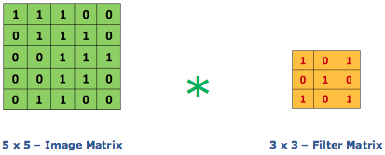
Image matrix multiplies kernel or filter matrix
3 x 3 Output matrix

Slide 14
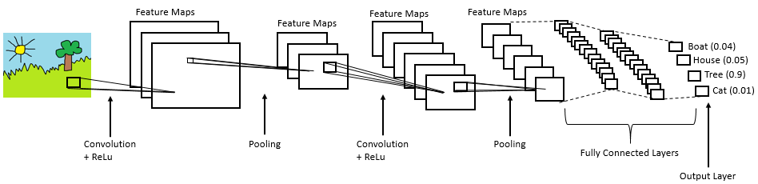
Complete CNN architecture

Slide 15
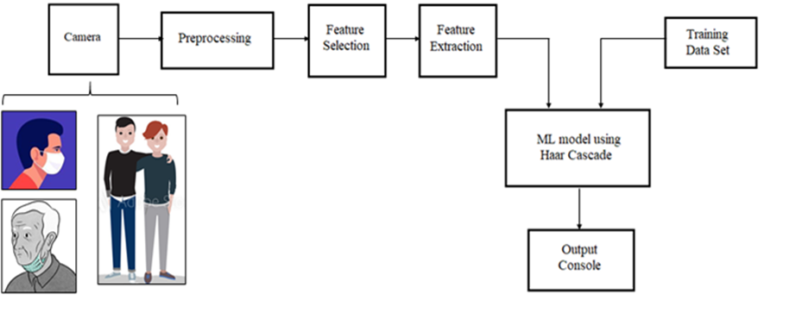
FLOWCHART

Slide 16
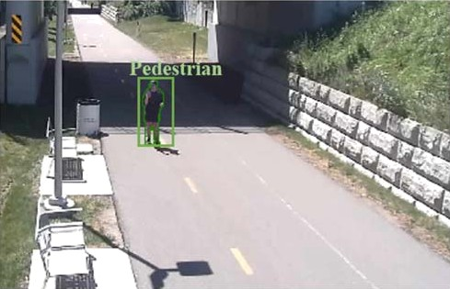
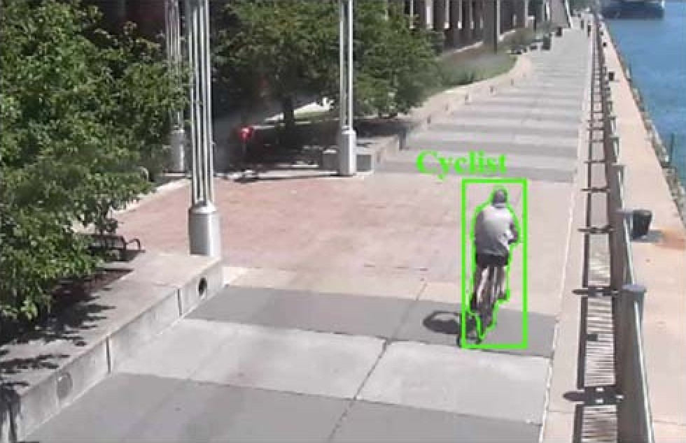
RESULTS
a) Pedestrian Classification b) Cyclist Classification

Slide 17
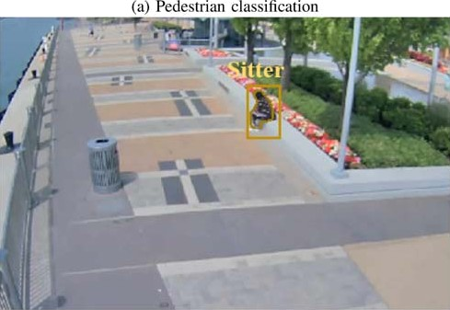
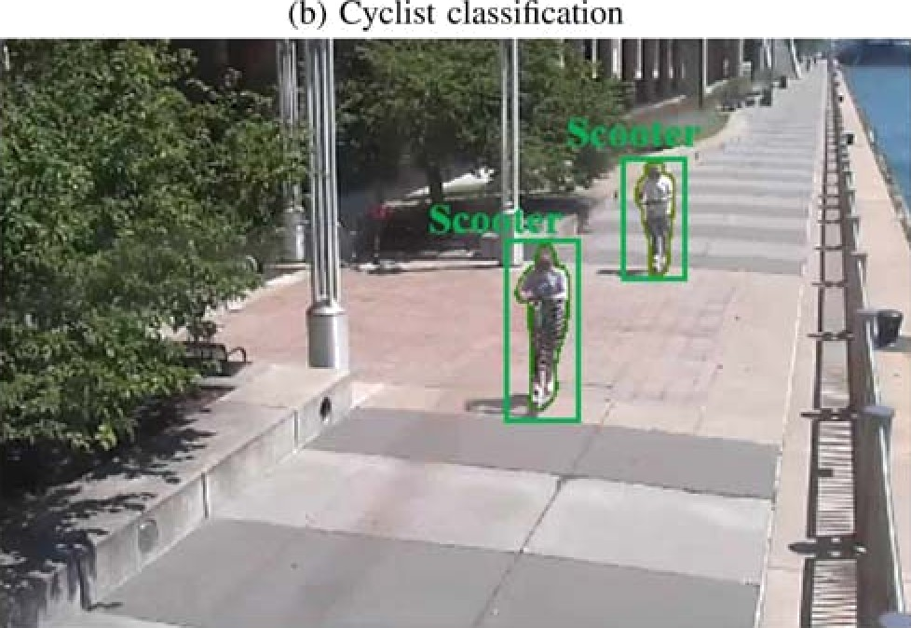
Examples of Mask R-CNN person detection and activity classifications on frames taken from surveillance cameras at the Detroit Riverfront.
(c) Sitter classification
(d) Scooter classification

Slide 18
CNN’s can perform person detection and face mask classification with high accuracy. The framework is designed for use in urban environments and leverages AWS cloud infrastructure to equip communities and stakeholders with actionable data. With an average precision of 89 or higher for person classes and a face mask classification accuracy of 96 & over, the framework can accurately track number of individuals and face masks present in a camera’s field of view. How- ever, the tracking capabilities of the framework are currently limited to one camera. The framework can not track people as they move between different fields of view. Additionally, if a person leaves a camera’s field of view and returns a few minutes later, the tracker will create a new ID for them, and the person will be counted twice. In the future, to address these challenges, a re-identification module will be added to the framework.
CONCLUSION

Slide 19
REFERENCES
1) P. Viola, M. Jones. 2003. Rapid object detection using a boosted cascade of simple features.
2) Mulla,,M., Patil, R. 2015 .Facial Image Based Security System using PCA.
3) Sahani, M., Nanda, C., Sahu, A., Pattnaik, B. 2015.Web Based Online Embedded Door Access Control and Home Security System Based on Face Recognition.

Slide 20
THANK YOU ALL

